Slide 1

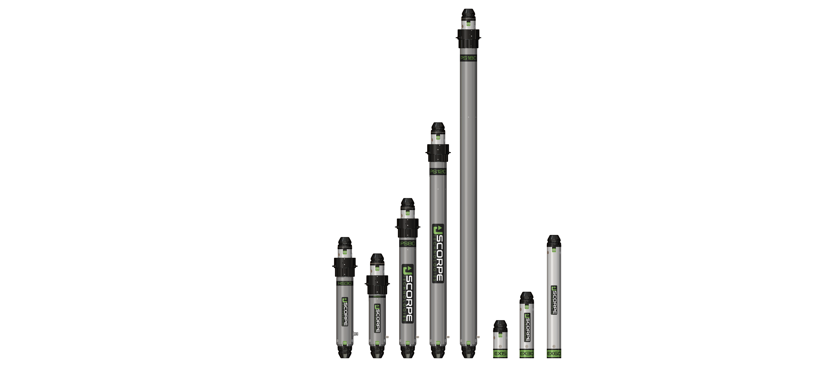
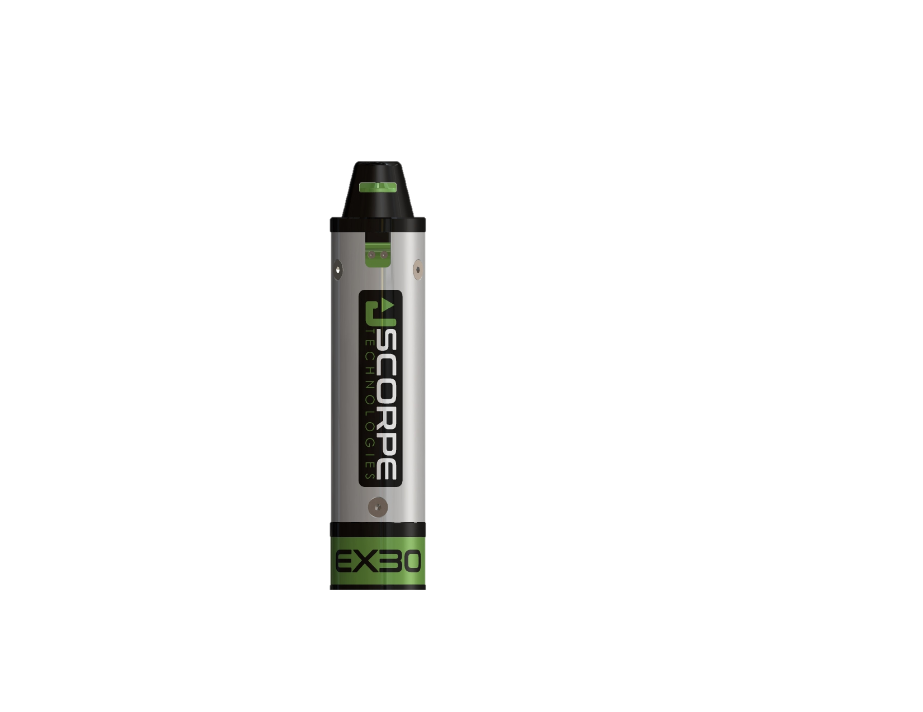
HEAVY DUTY STRUTS

Slide 2
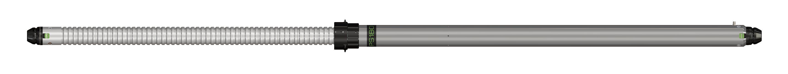
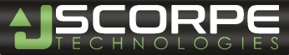
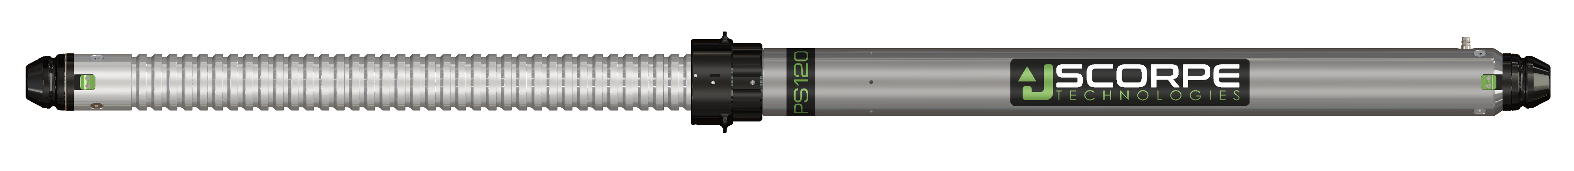
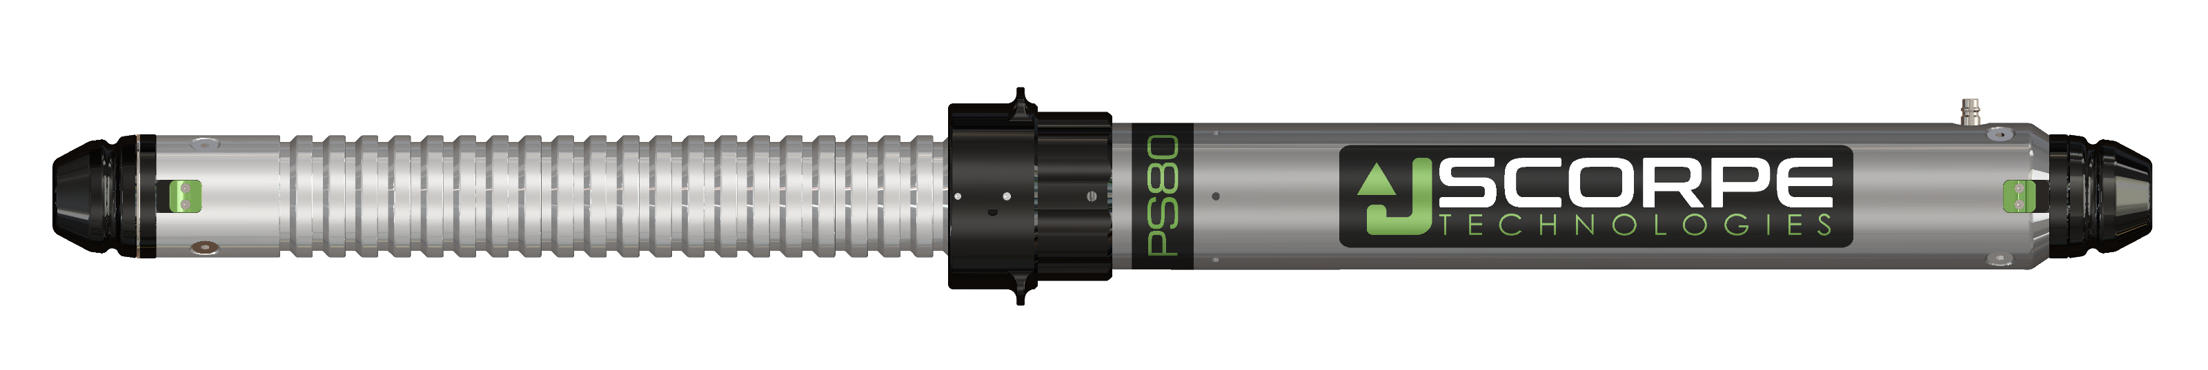
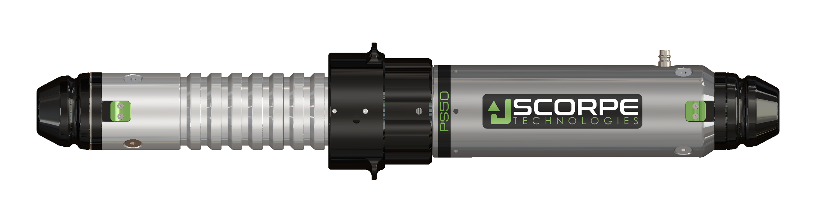
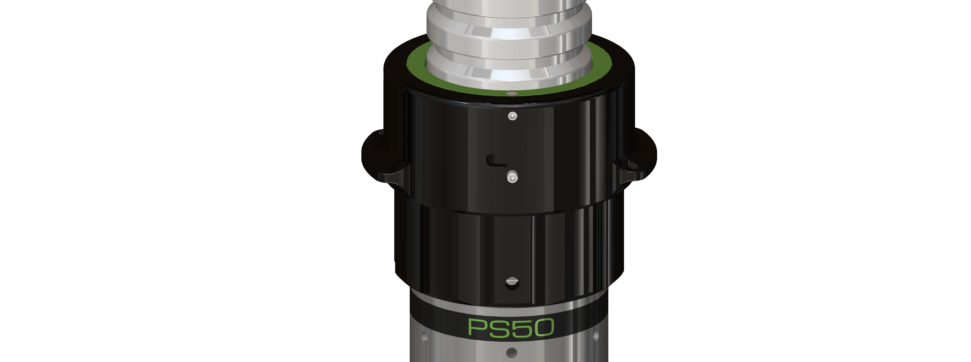
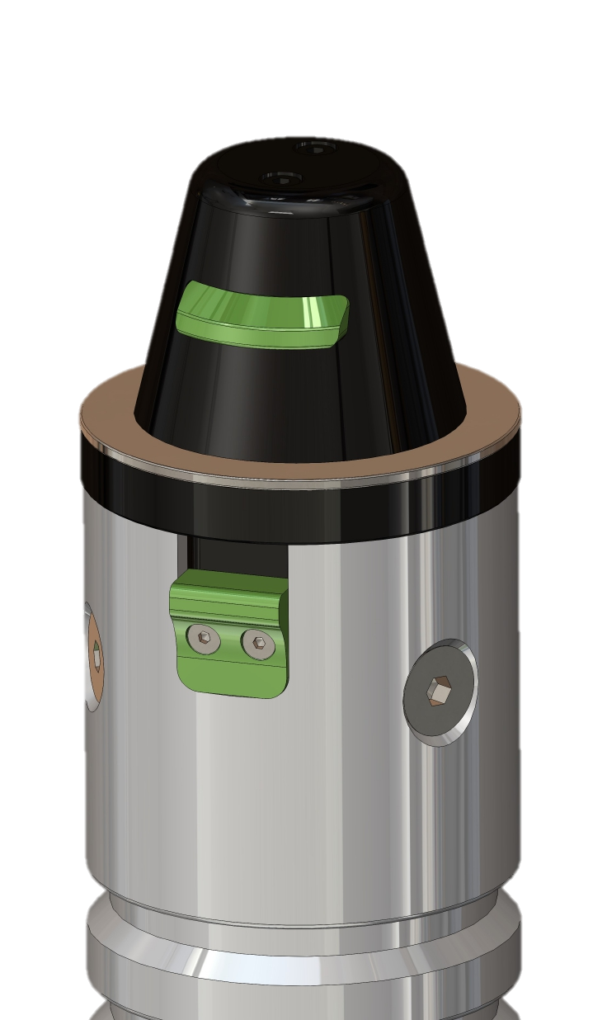
PNEUMATIC STRUTS
PS180
Weight: 15,8kg
Length: 183-297cm
Stroke: 114cm
PS120
Weight: 11,2kg
Length: 123-199cm
Stroke: 76cm
PS80
Weight: 8kg
Length: 83-127cm
Stroke: 44cm
PS50
Weight: 5,7kg
Length: 53-71cm
Stroke: 18cm
Unlocking accessories by lifting a button
Possibility of cancelling automatic locking
Threaded ring to compensate for the distance between 2 positions
Press the upper part to release the rod

Slide 3
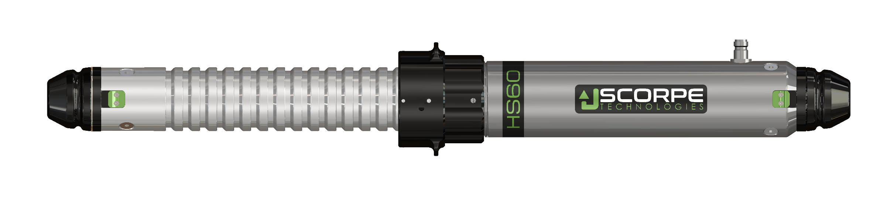
HYDRAULIC STRUT
HS60
Weight: 13kg
Length: 63-93cm
Stroke: 30cm
Can be used as a jack to lift the load
Unlocking accessories by lifting a button
Possibility of cancelling automatic catch-up
Threaded ring to compensate for the distance between 2 positions
Press the upper part to release the rod

Slide 4
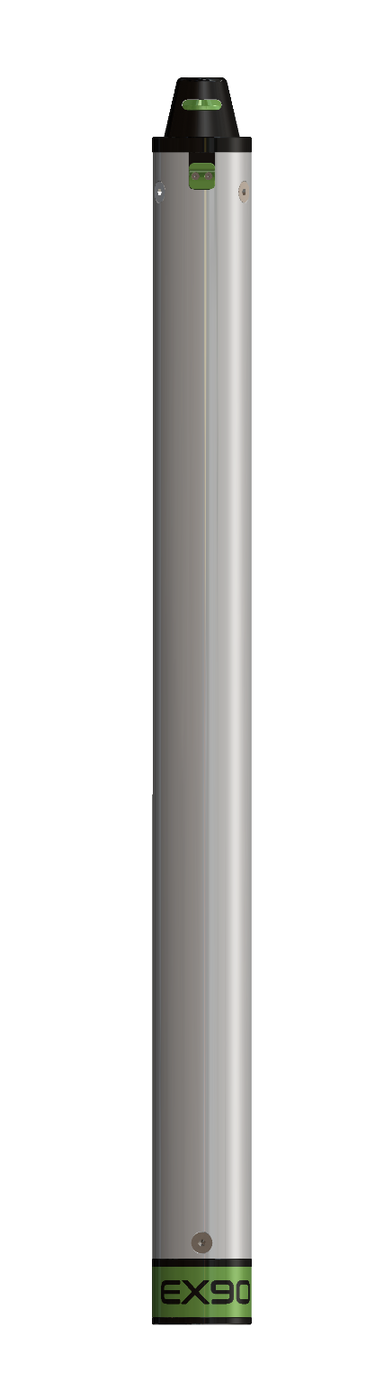
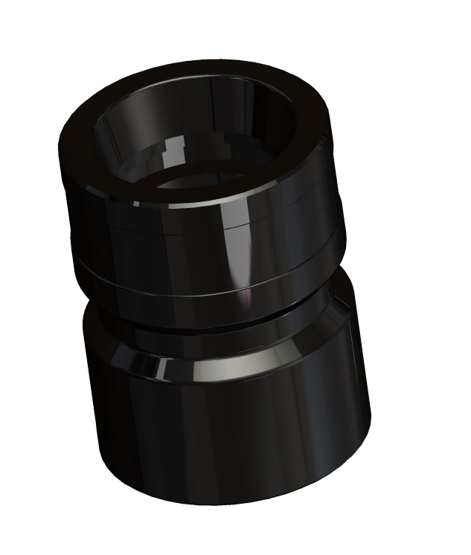
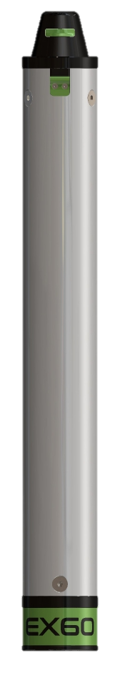
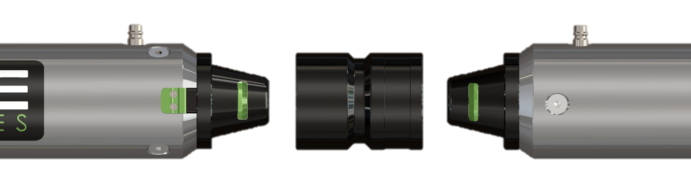
EXTENSIONS
EX90
Length: 90cm
Weight: 3,7kg
FF coupling
For connecting 2 struts
Weight: 0,7kg
EX60
Length: 60cm
Weight: 2,8kg
EX30
Length: 30cm
Weight: 2kg

Slide 5
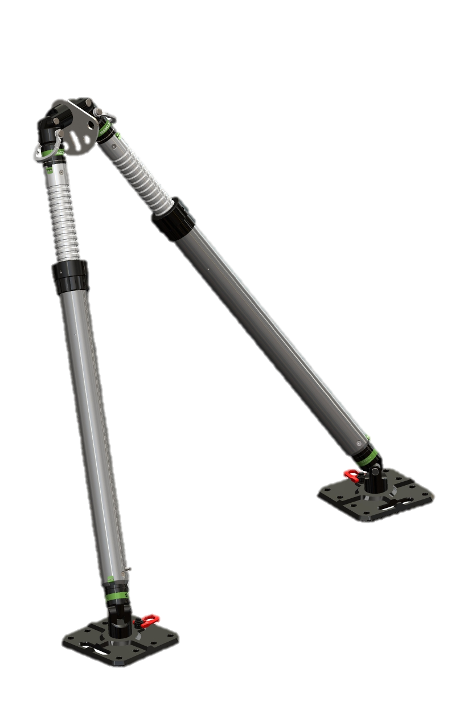
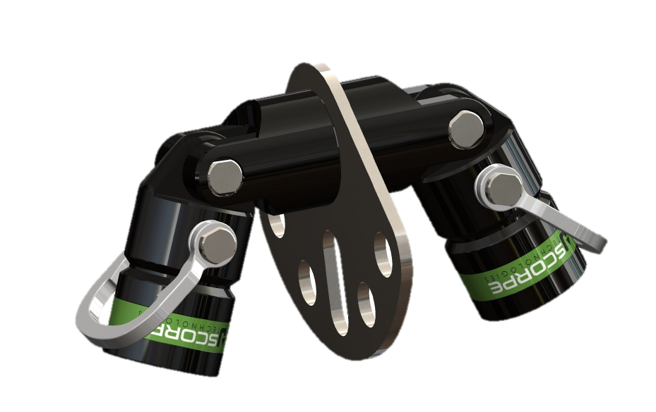
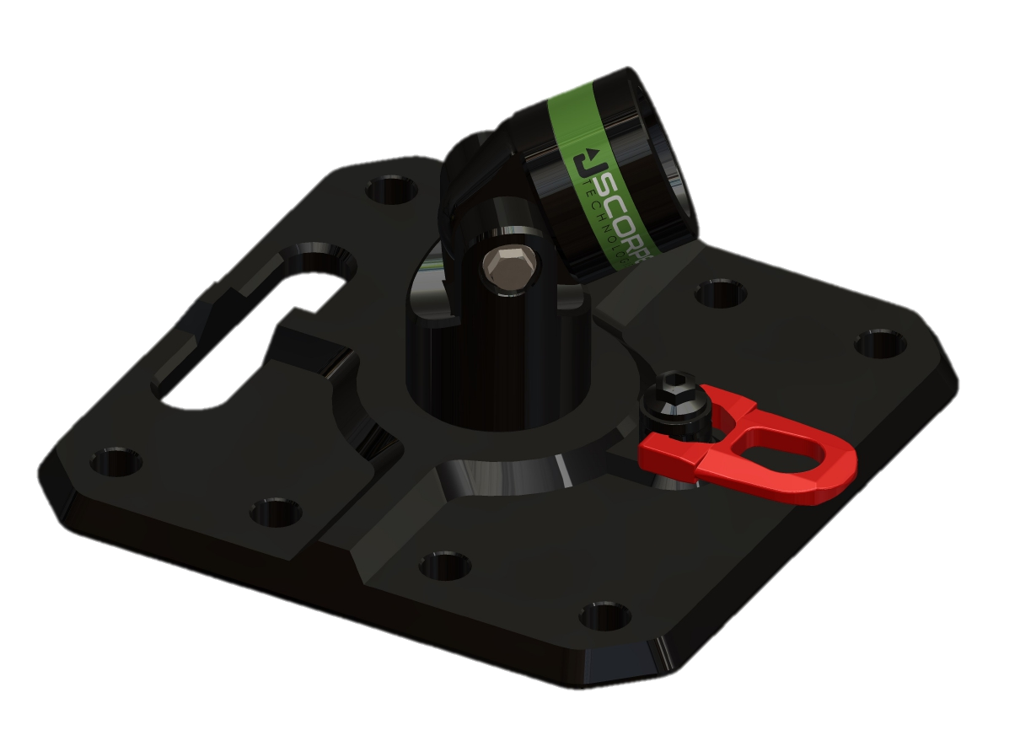
DuoStab Kit
DuoStab Head
Weight: 5,5kg
Dimensions: 28x25x20cm
Each head pivots through 180° and is fitted with a shackle.
Heavy-duty lashing plate
DuoStab Base (x2)
Weight: 5kg
Dimensions: 30x30x14,5cm
Head with double pivot
Rotating anchor loop
PS120 or PS180 (x2)

Slide 6
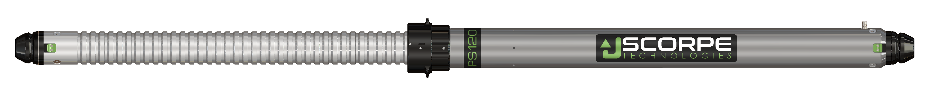
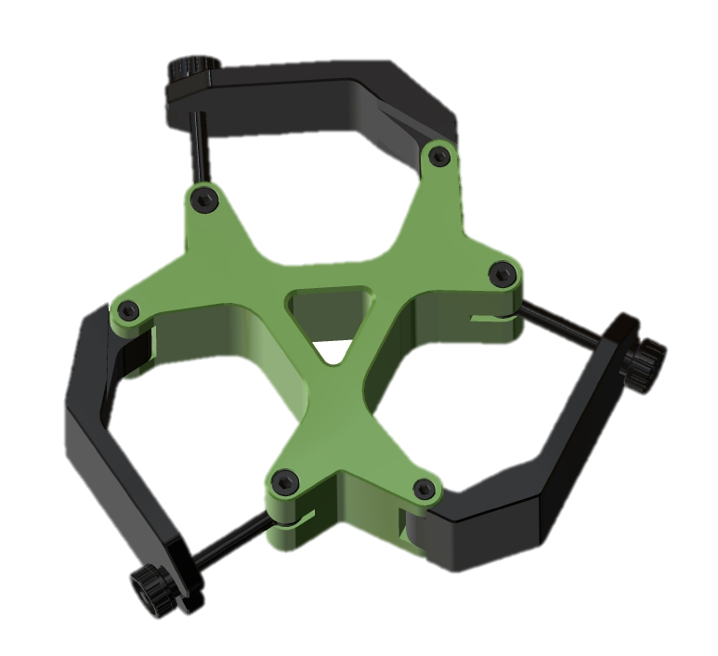
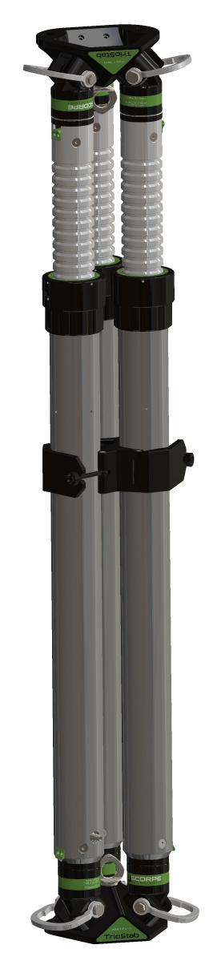
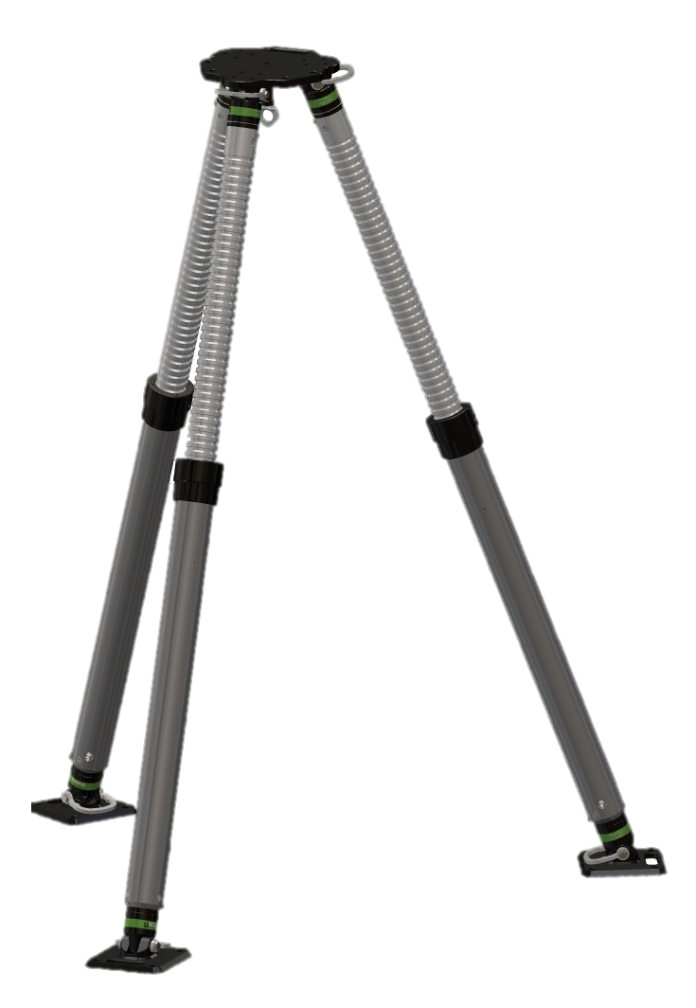
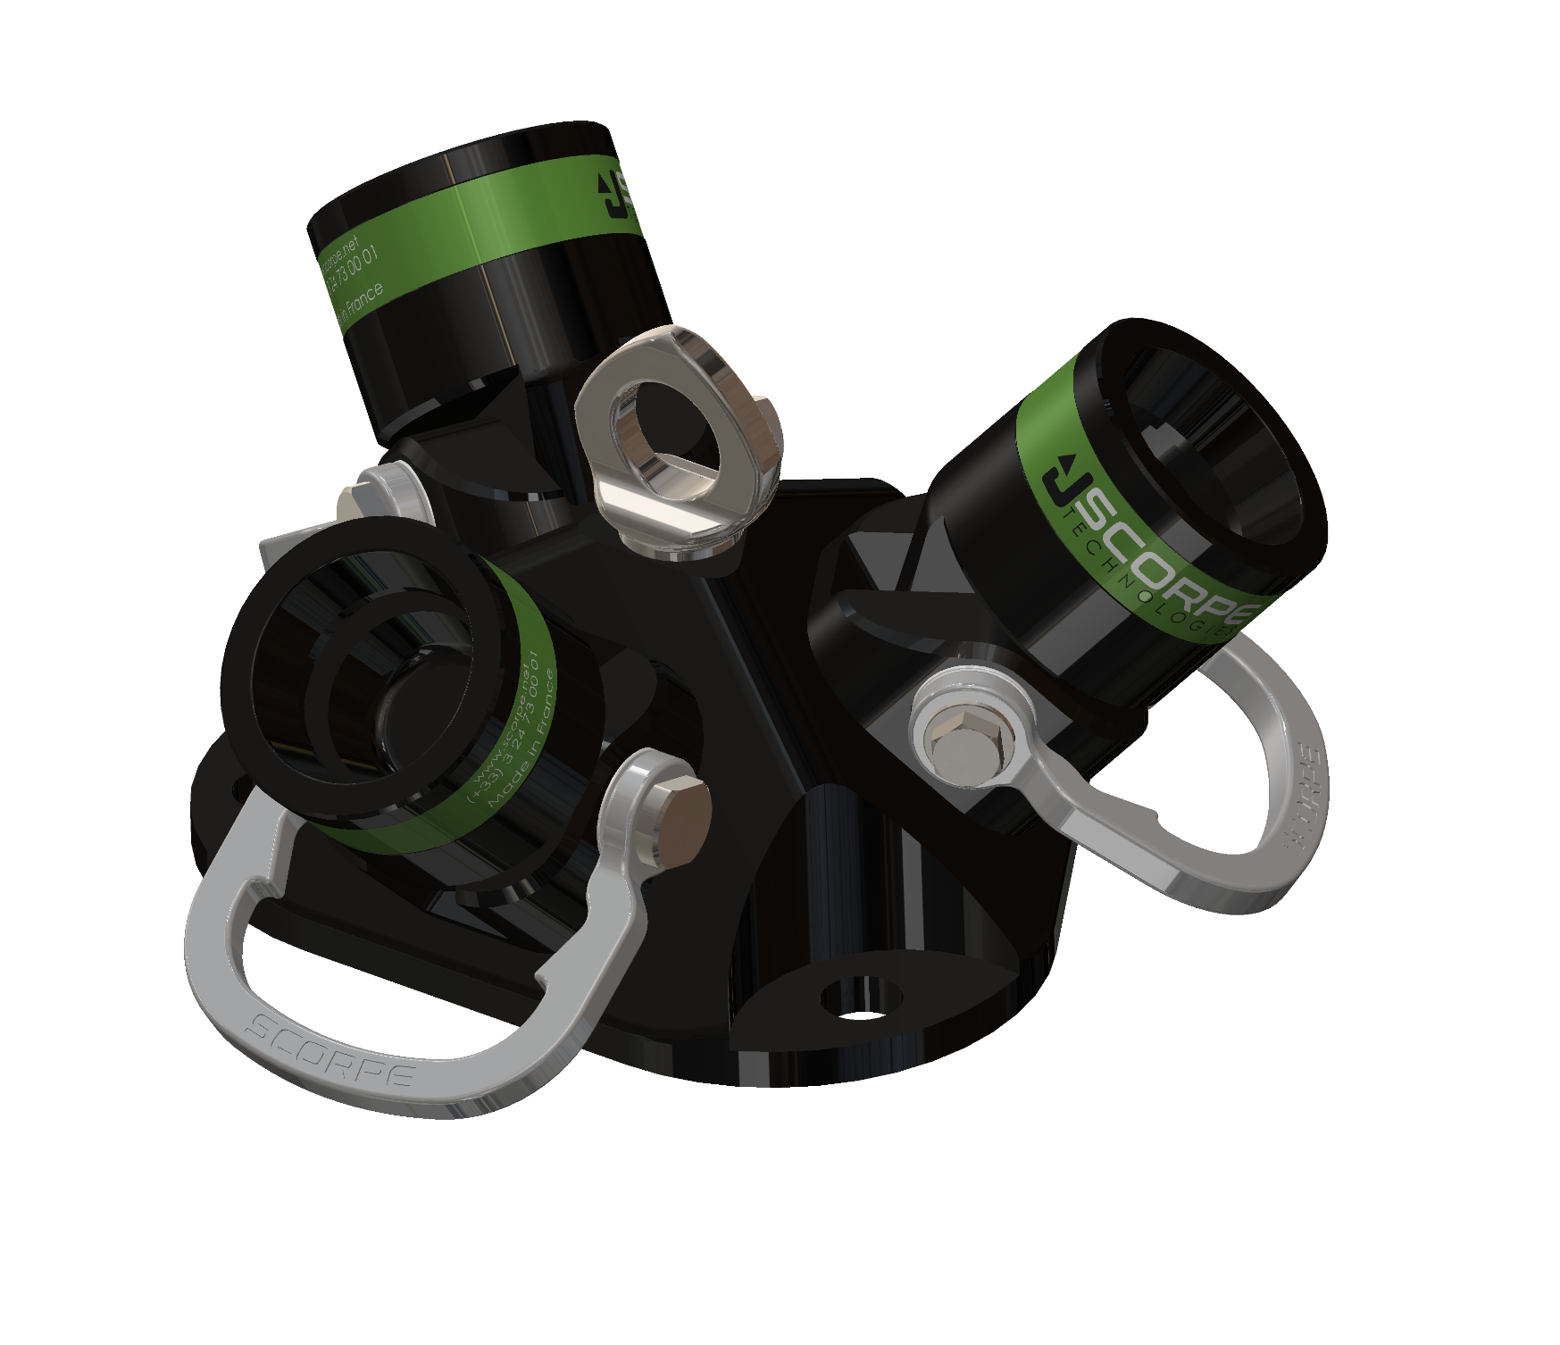
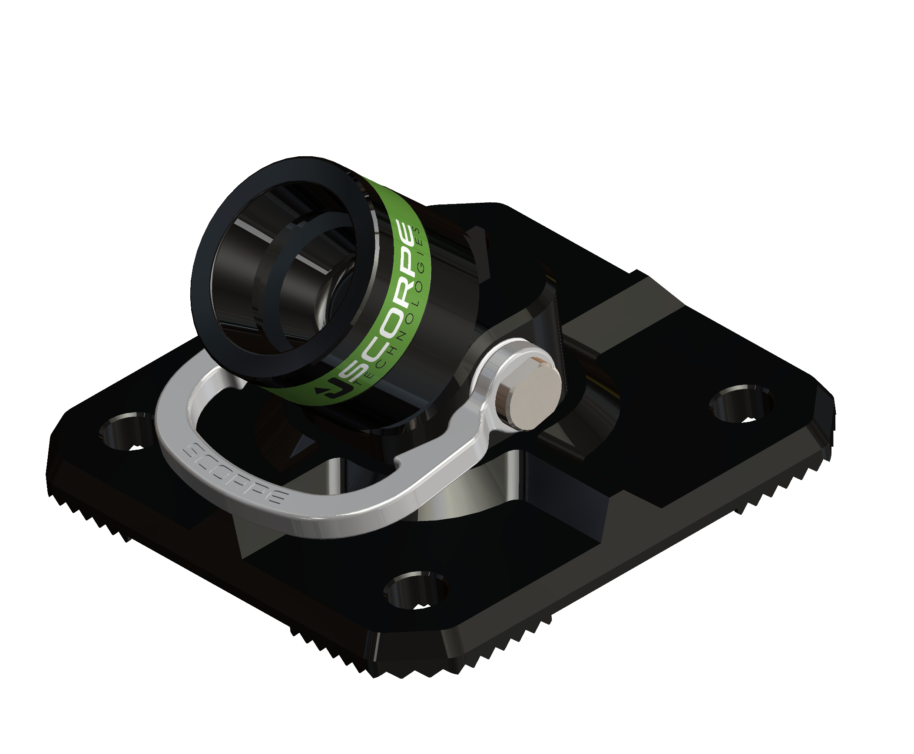
TrioStab Kit
TrioStab Brid
Weight: 4,7kg
Dimensions: 28x27x7,6cm
PS120 or PS180 (x3)
TrioStab Base (x2)
Weight: 6,5kg
Dimensions: 27x24x14cm
Each head pivots through 45° and is fitted with a shackle
Central lifting ring
45° Pivot Base(x3)
Weight: 2,6kg
Dimensions: 20x20x11cm
45° swivel head fitted with a shackle

Slide 7
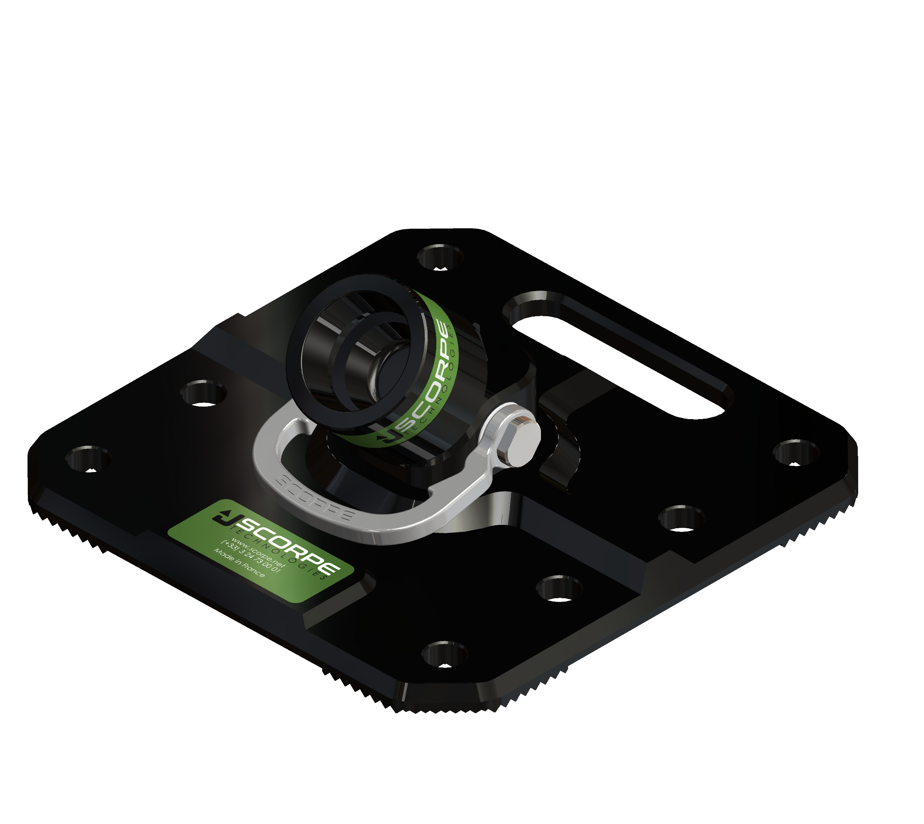
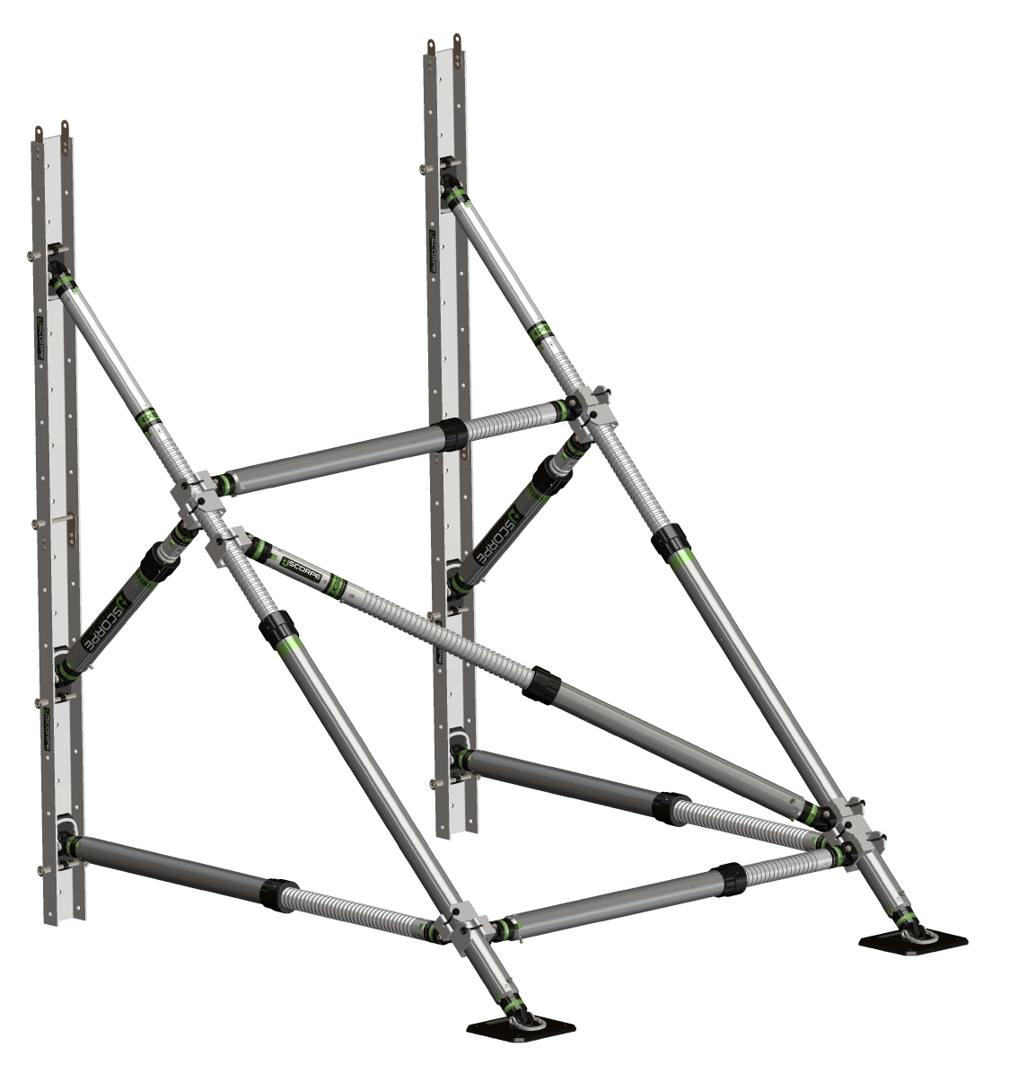
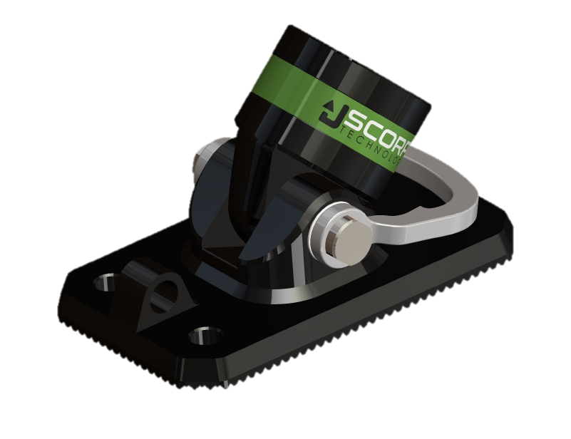
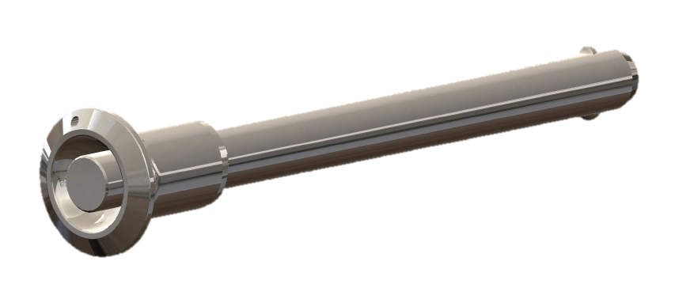
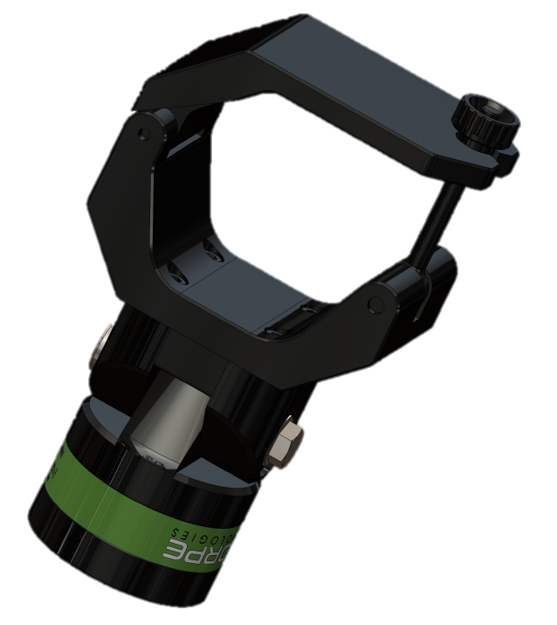
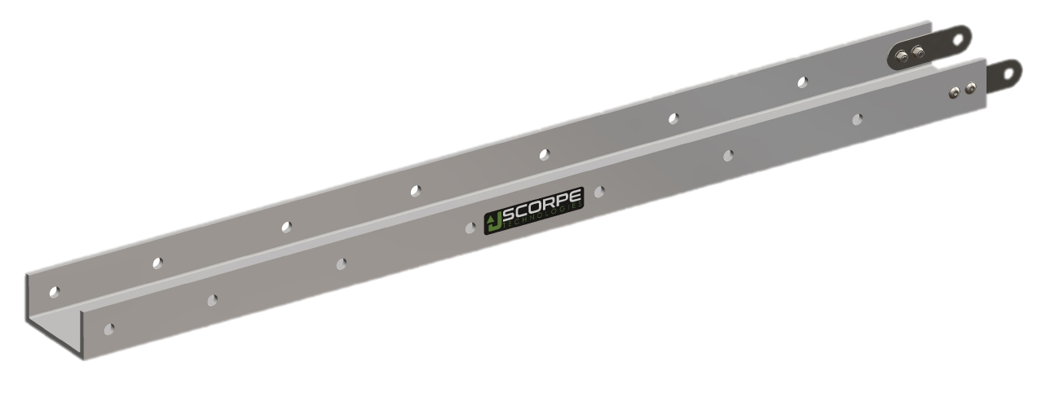
Buttress Kit
Pin (x8)
Rail Base(x6)
Weight: 1,8kg
Dimensions: 20x12x11cm
Pivot Base 300(x2)
Weight: 4kg
Dimensions: 30x30x11cm
Rail (x4)
Weight: 8kg
Dimensions: 146x14x7cm
Tightening Head(x10)
Weight: 2,2kg
Dimensions: 23x13x7,6cm

Slide 8
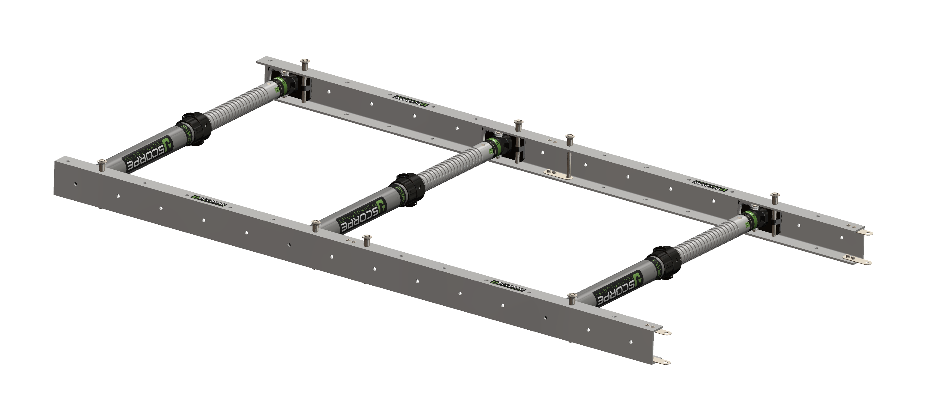

Trench Kit
Pin (x8)
Rail Base(x16)
Weight: 1,8kg
Dimensions: 20x12x11cm
EX30 (x8)
PS80 (x8)
Rail (x4)
Weight: 8kg
Dimensions: 146x14x7cm

Slide 9
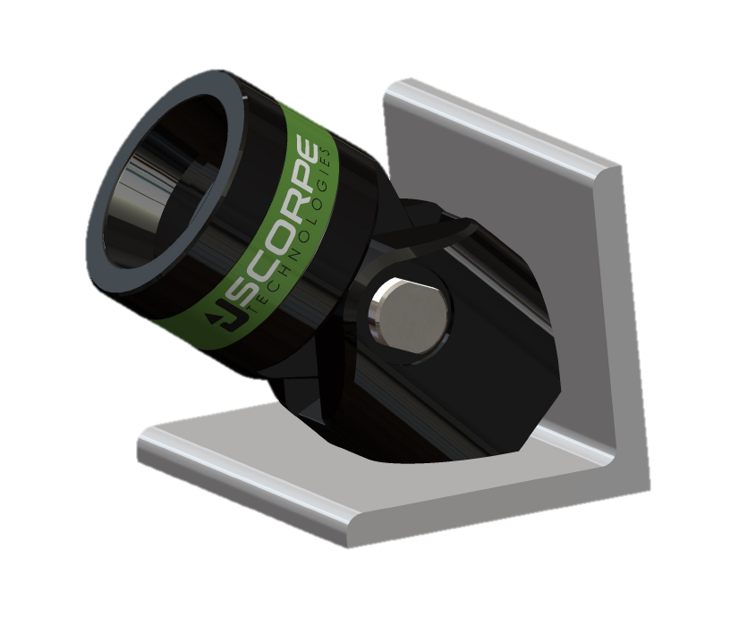
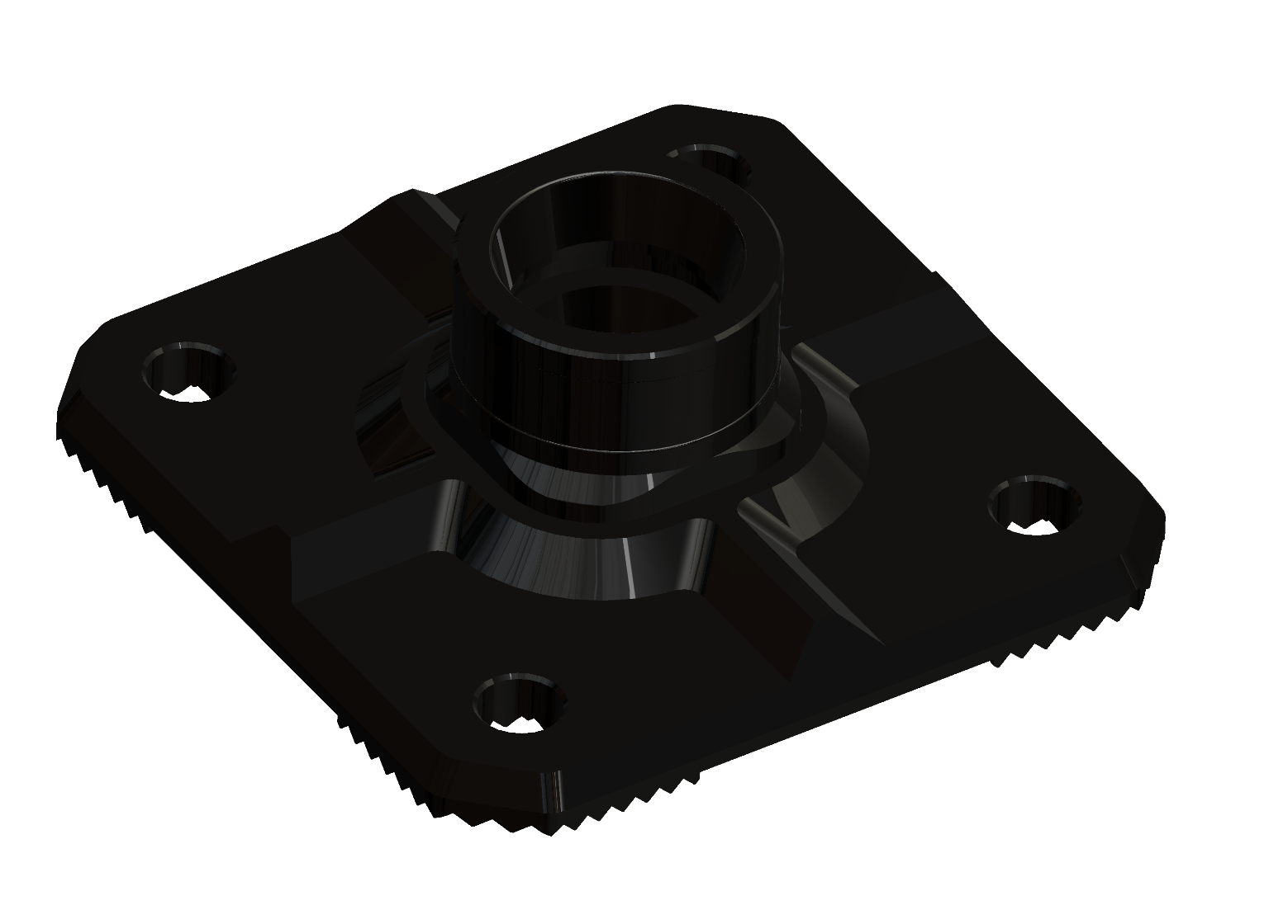
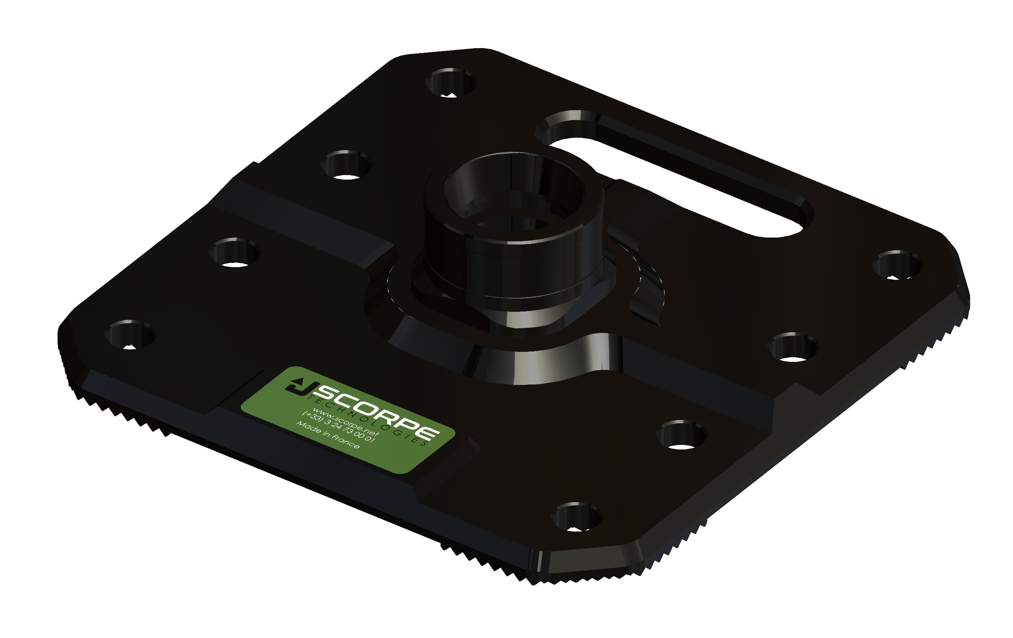
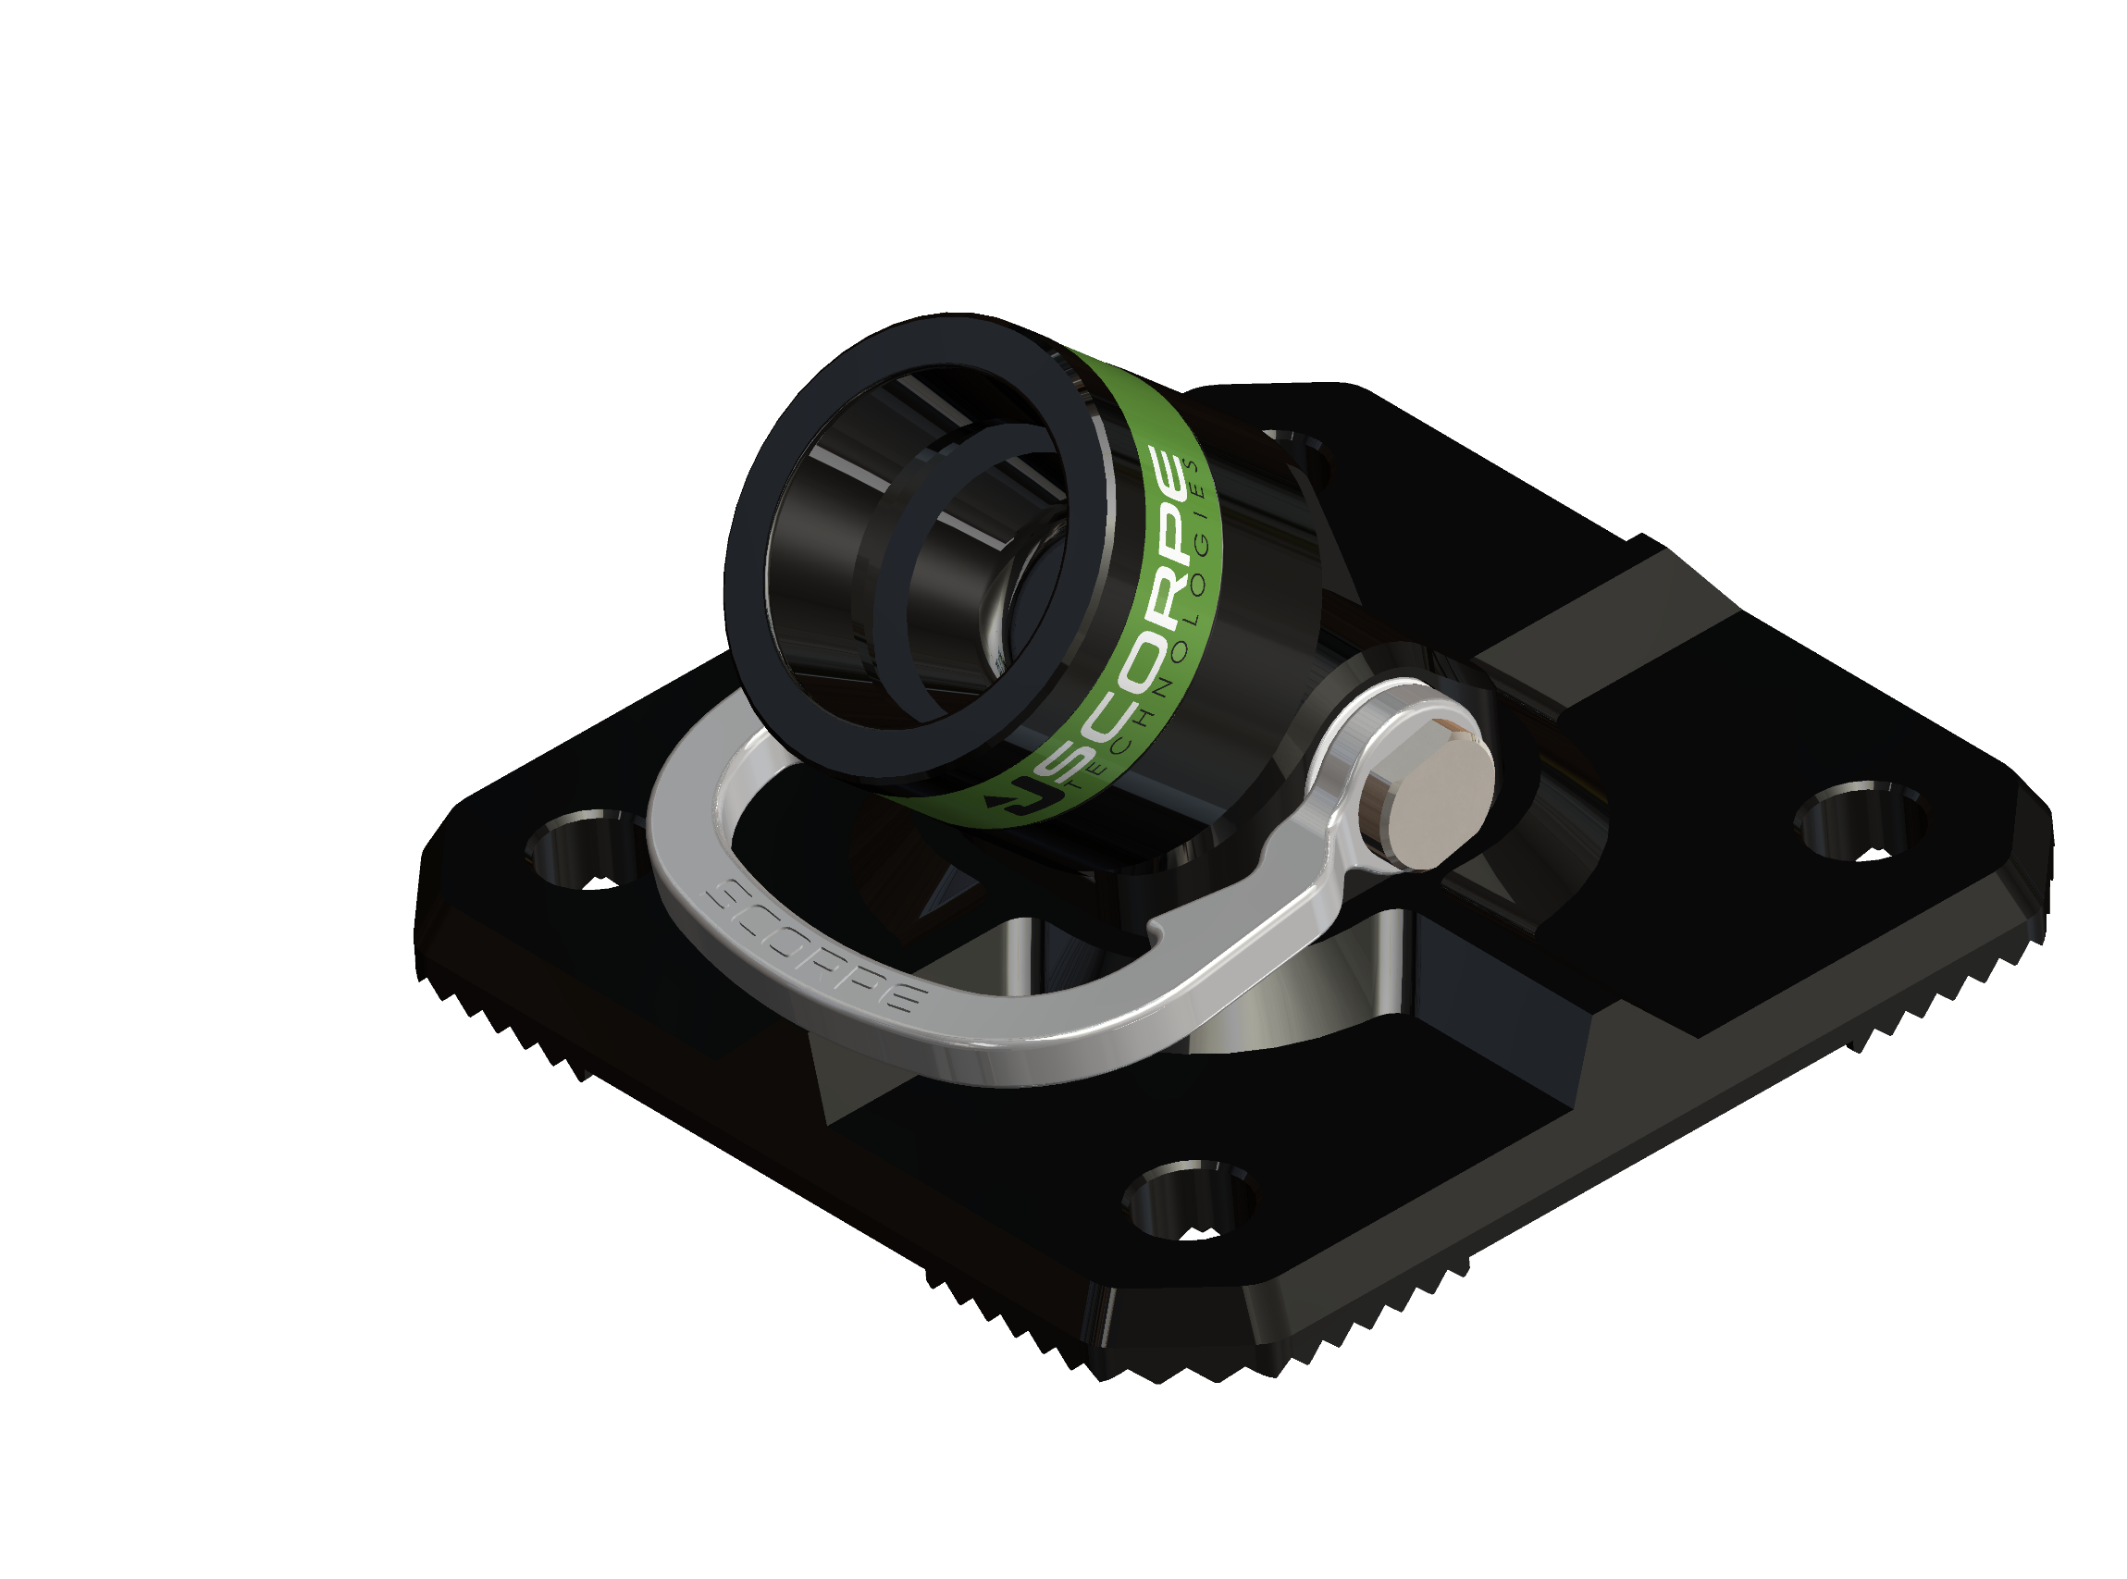

Bases
L Base
Weight: 2kg
Dimensions: 15x13x10cm
Fixed Base 200
Weight: 1,1kg
Dimensions: 15x15x5,8cm
Fixed Base 300
Weight: 2,8kg
Dimensions: 30x30x5,8cm
90° Pivot Base
Weight: 2,5kg
Dimensions: 20x20x11cm
45° Pivot Base
Weight: 2,6kg
Dimensions: 20x20x11cm

Slide 10
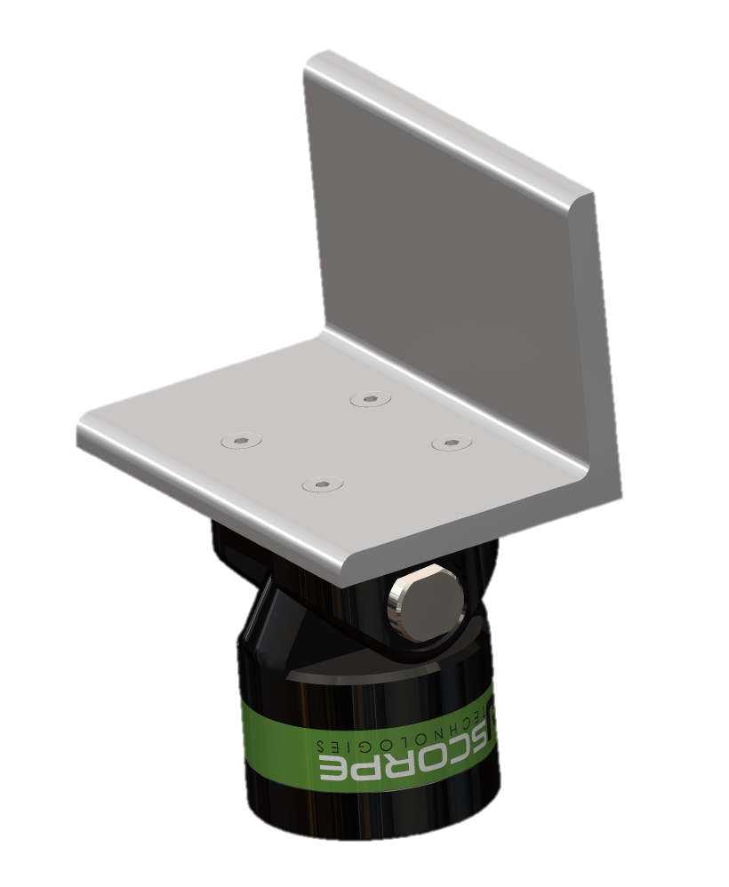
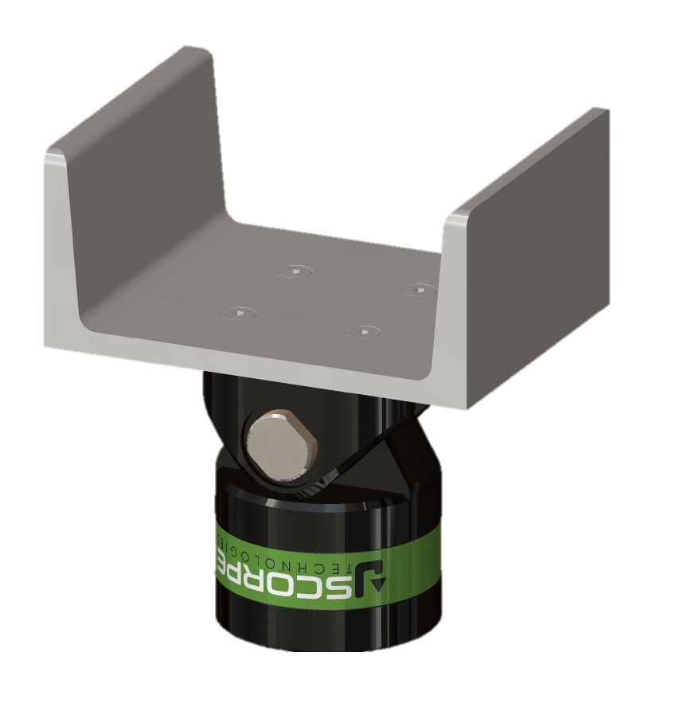
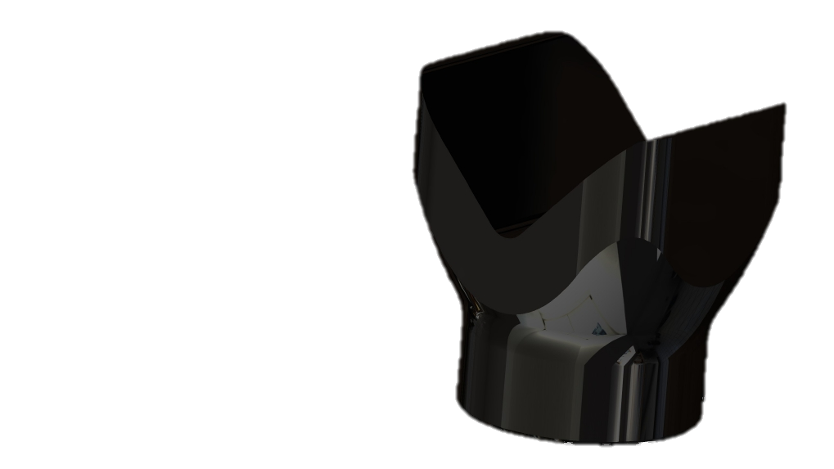
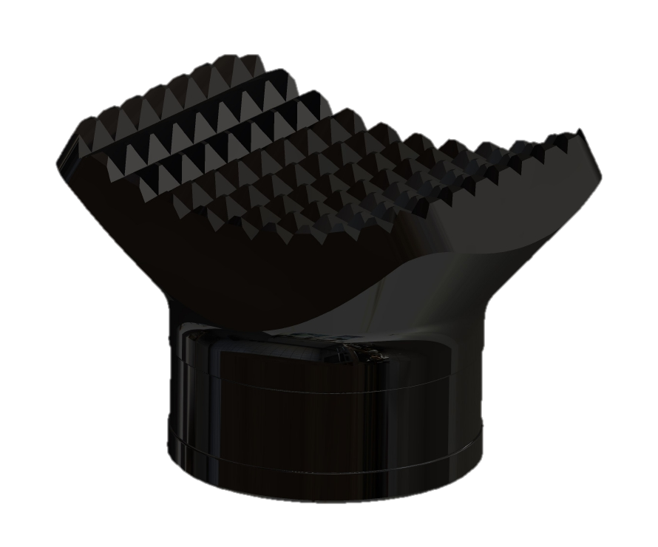
Heads
V Head
Weight: 1,1kg
Dimensions: 10x8x10,5cm
L Head
Weight: 1,8kg
Dimensions: 15x10x20cm
U Head
Weight: 1,9kg
Dimensions: 15,6x12x17,5cm
Concave Head Weight: 0,8kg
Dimensions: 12x8x8cm

